Slide 1
Building Contextual Data from Online Sources
Nathan R. Jones
University of Wisconsin Survey Center
github.com/nrjjones/BuildingContextualData
Summer DemSem 2018

Slide 2
Motivation
How can I extend the utility of data I already have?
What else can I find out about the world?
Can I make nice looking things?
General problem solving using R, but relevant to other tools
Tried to choose real examples, not toys
Data that looks like your data
Do things that you normally do with your data

Slide 3
Some words about R
R is a free, open source statistical application
RStudio is a free, open source GUI for R
R has lots of free, open source helper tools called packages

Slide 4
Some words about R
R is a free, open source statistical application
RStudio is a free, open source GUI for R
R has lots of free, open source helper tools called packages
We are going to use packages to:
Open files
Work with many data types simultaneously
Interact with websites
Make tables and maps
Save files in different formats

Slide 5
Suggestions for this session
If you don’t know R, don’t worry!
Are the output and flexibility worth the effort for you to learn R?
SSCC has you covered:
R Programming and Concepts starting on June 11
R for Researchers at fall semester bootcamp
If you do know R, here is a link to the GitHub page for this presentation
github.com/nrjjones/BuildingContextualData

Slide 6
Is there another way?
What are you comfortable with?
R is a comprehensive set of tools
All of this is possible with Python
Probably possible with Stata/SAS/SPSS plus some other tools

Slide 7
The hard way (covered by Liam)
What I had planned...
Go to site that provides data
Scrape information from page or, if lucky, use API
Clean whatever craziness comes back
Build a new database
Merge, analyze, map, etc

Slide 8


Slide 10
What is an API?
Application programming interface
Easy way to interact with database behind the website

Slide 11
What is out there?
Gas prices
https://www.gasbuddy.com/home?search=53705&fuel=1
Housing prices from Zillow API
https://www.zillow.com/howto/api/APIOverview.htm
Crime data from FBI API
https://crime-data-explorer.fr.cloud.gov/api
Twitter API
https://developer.twitter.com/en/docs/tweets/search/overview

Slide 12
What is out there?
Gas prices
https://www.gasbuddy.com/home?search=53705&fuel=1
Housing prices from Zillow API
https://www.zillow.com/howto/api/APIOverview.htm
Crime data from FBI API
https://crime-data-explorer.fr.cloud.gov/api
Twitter API
https://developer.twitter.com/en/docs/tweets/search/overview

Slide 13
For this presentation
Google Maps API
https://developers.google.com/maps/documentation
Zip Atlas
http://zipatlas.com

Slide 14
Helpful packages
Package | What it does
tidyverse | Data manipulation tools
httr | Command line web tool
jsonlite | Converts output to other data format
tidycensus | Interacts with Census API
ggmap | Interacts with Google Maps API
rvest | Web page scraping tool

Slide 15
What can I do with data I already have?
Sample file with demographic and health data
ID | BMI | Zip | County | Address
1001
1002
1003
1004
1005
1006
1007
1008

Slide 16
What can I do with data I already have?
Sample file with demographic and health data
ID | BMI | Zip | County | Address
1001 | 24.8 | 53515 | Dane
1002 | 27.2 | 53521 | Dane
1003 | 28.5 | 53716 | Dane
1004 | 32.1 | 51646 | Dane
1005 | 29.7 | 52305 | Dane
1006 | 22.8 | 51149 | Dane
1007 | 23.5 | 57903 | Dane
1008 | 31.2 | 56098 | Dane

Slide 17
Adding contextual data – 3 examples
Socioeconomic environment
Find zip code level poverty rates
Access to healthy food
Find closest (presumably) higher quality food source
Health care options
Find urgent care centers within 2 mile radius

Slide 18
Adding contextual data – 3 examples
Socioeconomic environment
Standard web scrape, programmatic URL creation
Access to healthy food
Use Google API directly
Health care options
Use R tools that interact with Google API

Slide 19
Adding contextual data – 3 examples
Socioeconomic environment
Find zip code level poverty rates
Access to healthy food
Find closest high quality food source
Health care options
Find urgent care centers within 25 min drive

Slide 20
Example 1: Socioeconomic environment

Slide 21
Example 1: Socioeconomic environment
Code available in /fun subdirectory on GitHub
build.zip.df()

Slide 22
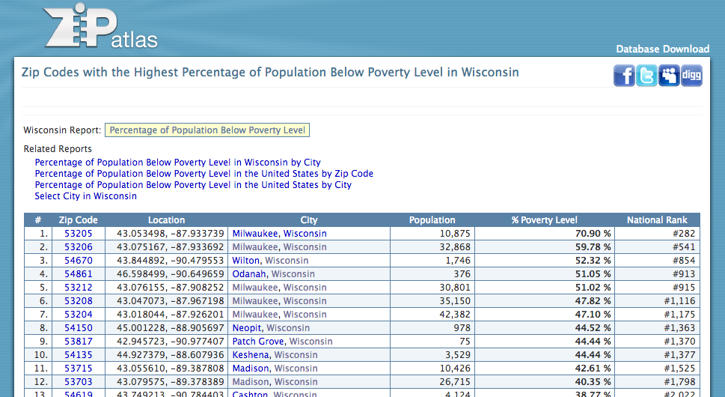
Example 1: Socioeconomic environment

Slide 23
Example 1: Socioeconomic environment
Strategy
Copy first page
Isolate table
Clean up table
Return data
Go to next page, next, …, last page
Isolate, clean, and then append to main data

Slide 24
Example 1: Socioeconomic environment

Slide 25
Example 1: Socioeconomic environment

Slide 26
Example 1: Socioeconomic environment

Slide 27
Example 1: Socioeconomic environment

Slide 28
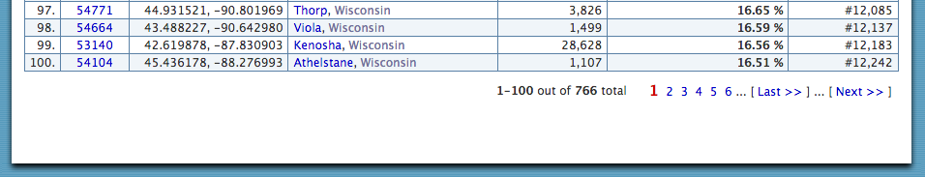
Example 1: Socioeconomic environment

Slide 29
Example 1: Socioeconomic environment

Slide 30
Review function
build.zip.df <- function(x) {
tmp <- read_html(x) %>%
html_node("table") %>%
html_table(fill=TRUE)
# Clean up junk in the table
tmp <- tmp[1:7]
tmp <- tmp[-c(1:12), ]
names(tmp) <- tmp[1, ]
tmp <- tmp[-1, ]
tmp <- tmp[-c(101:105), ]
return(tmp)
}

Slide 31
Example 1: Socioeconomic environment
# Initialize data with first page
zip.df <- build.zip.df("http://zipatlas.com/wi/population-below-poverty-level.htm")
# Loop through rest of pages
for(i in 2:8) {
link <- paste0(”[BASE URL]", i, ".htm")
tmp <- build.zip.df(link)
zip.df <- bind_rows(zip.df, tmp)
}

Slide 32
Example 1: Socioeconomic environment
# Initialize data with first page
zip.df <- build.zip.df("http://zipatlas.com/wi/population-below-poverty-level.htm")
# Loop through rest of pages
for(i in 2:8) {
link <- paste0("[BASE URL]", i, ".htm")
tmp <- build.zip.df(link)
zip.df <- bind_rows(zip.df, tmp)
}

Slide 33
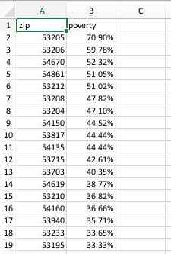
Example 1: Socioeconomic environment

Slide 34
Example 2: Access to healthy food

Slide 35
Example 2: Access to healthy food
Find nearby healthy food sources
Get list of coop grocery stores
Get location
Address
Lat/Lon
Get other information

Slide 36
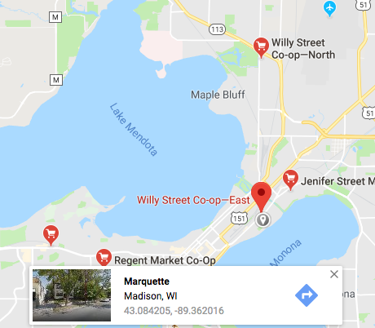
A very tedious way
Search for coop grocery stores
Drop some pins in Google Maps
Copy and paste the lat/lon
(Use some other lat/lon tool)
Create a dataset
Use GIS to map

Slide 37
Create URLs with code
Structure of query is
Google API base URL +
search term +
options

Slide 38
Create URLs with code
Structure of query is
https://maps.googleapis.com/maps/api/place/textsearch/json?query=
+
“Coop grocery in Dane County”
+
Search radius
+
Google API key

Slide 39
Google Search Scrape
Use R command paste0() to combine elements
The result is a looooooong URL
https://maps.googleapis.com/maps/api/place/textsearch/json?query=Coop+grocery+in+Dane+County&radius=50000&key=AIzaSyBZqWP3nojVe3fmUcv6YlZ2l1F5tozq

Slide 40
Google Search Scrape
Use R command paste0() to combine elements
The result is a looooooong URL
https://maps.googleapis.com/maps/api/place/textsearch/json?query=Coop+grocery+in+Dane+County&radius=50000&key=AIzaSyBZqWP3nojVe3fmUcv6YlZ2l1F5tozq
I saved this loooong Google URL as a thing called Gurl

Slide 41
Google search scrape strategy
From httr package, use GET() to copy the page
From jsonlite package, convert the page to data
Save what you need from the output

Slide 42
Google search scrape in 3 terse, magical steps
From httr package, use GET() to copy the page
From jsonlite package, convert the page to data
tmp1 <- GET(Gurl)
tmp2 <- content(tmp1, "text")
tmp3 <- fromJSON(tmp2)

Slide 43
“Coop grocery in Dane County”
Name | Lon | Lat | Address
Willy Street Co-op‚ North | -89.362809 | 43.1276093 | 2817 N Sherman Ave, Madison, WI 53704, USA
Yahara River Grocery Cooperative | -89.218717 | 42.9165114 | 229 E Main St, Stoughton, WI 53589, USA
Regent Market Co-Op | -89.423402 | 43.068052 | 2136 Regent St, Madison, WI 53726, USA
Willy Street Co-op‚ East | -89.362873 | 43.0837051 | 1221 Williamson St, Madison, WI 53703, USA
Willy Street Co-op‚ West | -89.500408 | 43.0964478 | 6825 University Ave, Middleton, WI 53562, USA
Premier Cooperative Supermarket | -89.747575 | 43.140273 | 917 Mills St, Black Earth, WI 53515, USA
Jenifer Street Market | -89.351479 | 43.0903834 | 2038 Jenifer St, Madison, WI 53704, USA
Nature's Bakery Co-Op | -89.367063 | 43.081091 | 1019 Williamson St, Madison, WI 53703, USA

Slide 44
Write a function
get20results <- function(x) {
thingtosearch <- gsub(" ", "+", x)
Gurl <- paste0([ALL THE PARTS OF THE URL])
tmp <- GET(Gurl)
tmp2 <- content(tmp, "text")
tmp3 <- fromJSON(tmp2)
tmp4 <- bind_cols(
name = tmp3...name,
lon = tmp3...lng,
lat = tmp3...lat,
address = tmp3...formatted_address
)
return(tmp4)
}

Slide 45
Concept review
If you have places, even roughly operationalized...
You can get a list of results from Google
You can get coordinates
You can get addresses
You can get open hours, ratings, etc

Slide 46
Quick aside
Location data the easy way!
Great tools that interact with Google already exist
R package ggmap does a lot!
Following examples will use several functions
geocode()
mapdist()
get_map()
ggmap()

Slide 47
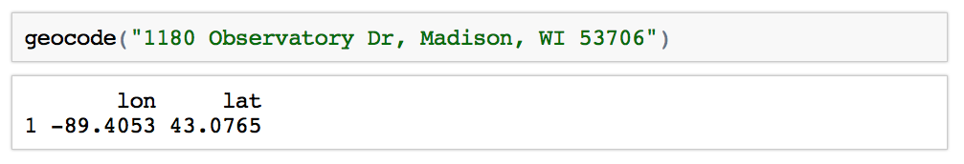
Location data the easy way!
ggmap’s function geocode()
It just works!

Slide 48
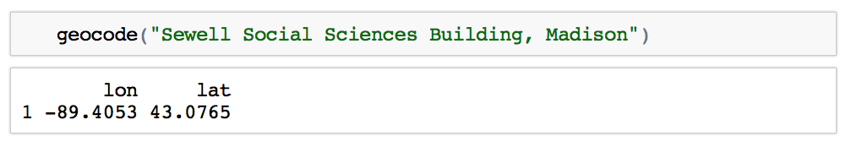
Location data the easy way!
ggmap’s function geocode()
And it can figure this out

Slide 49
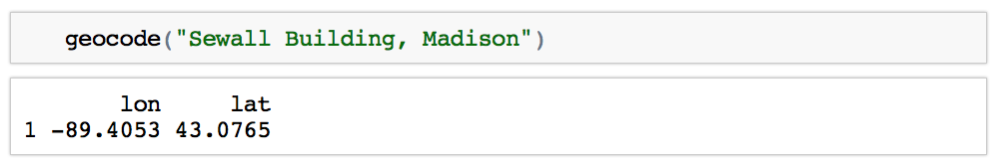
Location data the easy way!
ggmap’s function geocode()
And because we live in the future!

Slide 50
Mass geocoding the easy way
buildings <- read_csv(List of 200 buildings.csv)
geocoded_buildings <- geocode(buildings$name)
name | Lat | Lon
Building 1
Building 2
…
Building 200

Slide 51
Example 3: Health care options
So, now we know how to get location information from a search
Let’s create some relevant data
Distance to closest coop grocery
Distance to health care services
Density of health care services

Slide 52
Review function
get20results <- function(x) {
thingtosearch <- gsub(" ", "+", x)
Gurl <- paste0([ALL THE PARTS OF THE URL])
tmp1 <- GET(Gurl)
tmp2 <- content(tmp1, "text")
tmp3 <- fromJSON(tmp2)
tmp4 <- bind_cols(
name = tmp3...name,
lon = tmp3...lng,
lat = tmp3...lat,
address = tmp3...formatted_address
)
return(tmp4)
}

Slide 53
Use the function
Get the first 20 matches to any Google Map search
co <- get20results("Coop grocery in Madison")
NOTE You can get more than 20 by repeating the search and adding a token returned with the first search.

Slide 54
How far is it to nearest coop?
Use the mapdist() function to get travel distances, duration, other details, by mode!
from <- df$address
to <- co$address[1]
dist1 <- mapdist(
from,
to,
mode="bicycling",
output="simple”
)

Slide 55
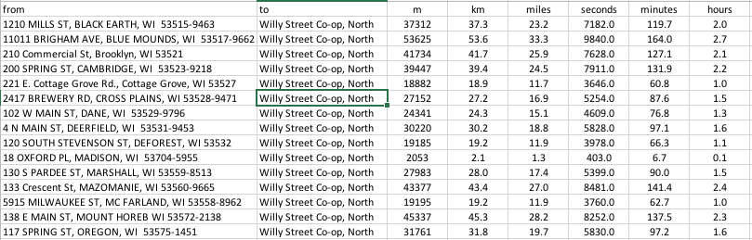
Results from mapdist()

Slide 56
Strategy for finding closest coop
Use mapdist() to get distance from each address to each coop
Make a long file of all results
Sort by address, then distance
Save the first result for each address and drop the rest
The result is the distance to the closest coop
Rename the variable to closest
Drop unneeded variables
Merge the closest into main data

Slide 57
dplyr makes it easy
closest <- dist %>%
arrange(from, miles) %>%
group_by(from) %>%
filter(row_number()==1)
cl_coop <- closest %>%
select(from, to, miles) %>%
transmute(
address = from,
name_closest_coop = to,
dist_closest_coop = miles
)

Slide 58
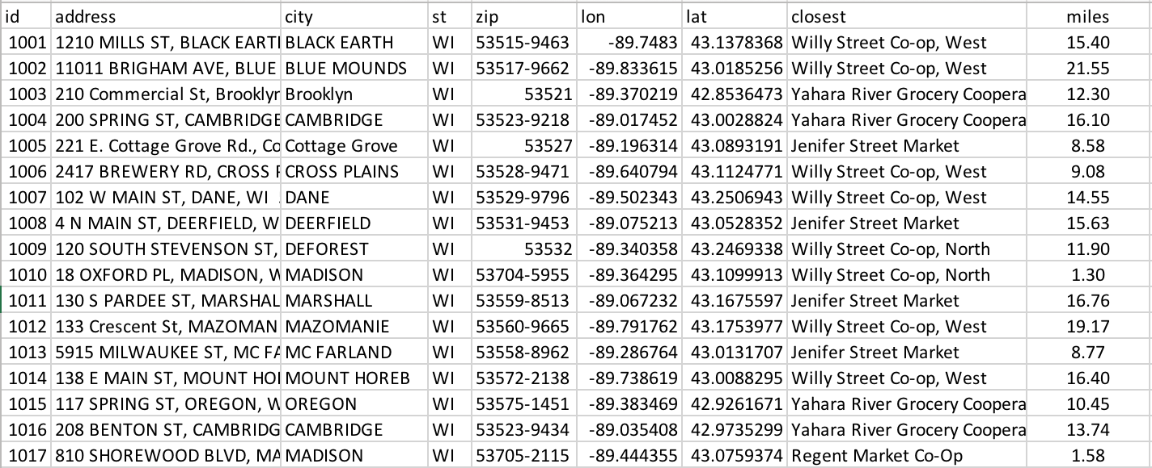
Merged into main data

Slide 59
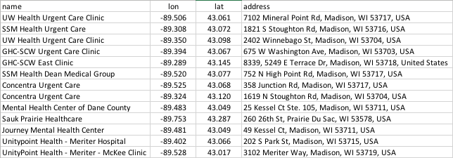
Search results…
uc <- get20results(”Urgent care center in Dane County")

Slide 60
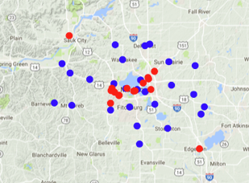
Map results…

Slide 61
dplyr to count urgent care within 25 mins
within25mins <- dist %>%
arrange(from, minutes) %>%
group_by(from) %>%
filter(minutes < 25) %>%
transmute( uc_num = n() ) %>%
group_by(from) %>%
filter(row_number()==1)

Slide 62
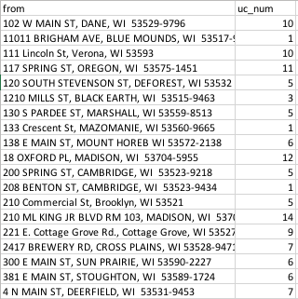
Merge results back into main data

Slide 63
Concept review
You can search the Google API for anything
You can automate a lot of the steps
You can extract a lot of information from the results
You can add new data and make maps

Slide 64
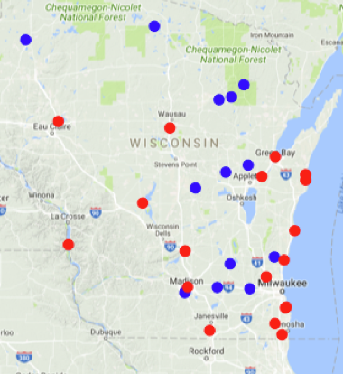
Really anything…
Use the function for a research question
pp <- get20results(”Power plants in WI")
hs <- get20results(”Fish hatcheries in WI")

Slide 65
Another example…
pp <- get20results("Planned Parenthood clinics in Atlanta")
hs <- get20results("Private high schools in Atlanta")

Slide 66
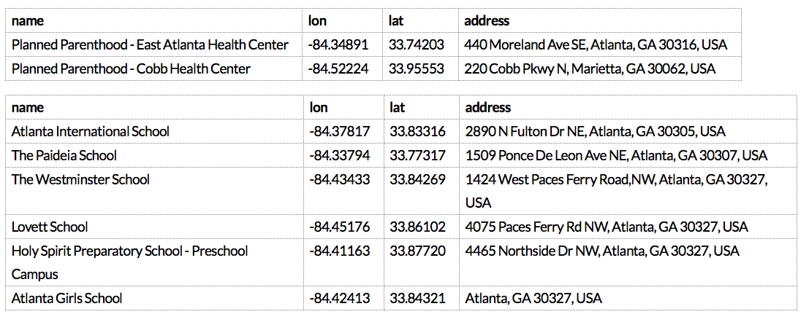
How far are reproductive health services?

Slide 67
Mapping is easy too
mdata <- get_map(location = "Atlanta, GA",
color = "color",
source = "google",
maptype = "terrain",
zoom = 10)
ggmap(mdata,
extent = "device",
ylab = "Latitude",
xlab = "Longitude") +
geom_point(data=pp, aes(x = lon, y = lat), color="red") +
geom_point(data=hs, aes(x = lon, y = lat), color="blue")

Slide 68
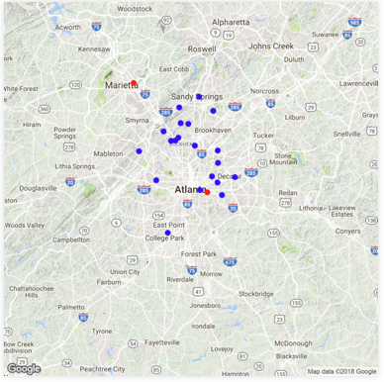
High schools and Planned Parenthoods

Slide 69
Another neat opportunity

Slide 70
Another neat opportunity
Combine your pocket GPS data logger with ggmap and Google API
Scrape EXIF data from your photos
Map!
image_files <-list.files("~/California")
tmp <- read_exif(image_files, tags=c("FileName", "GPSLatitude", "GPSLongitude"))

Slide 71
Another neat opportunity
The command list.files() created a list of ~1500 pictures by searching a folder on my desktop.
read_exif() from the exifr package extracted the lat and lon tags from my photos.
This took ~5 seconds.
And then…
brews <- getContext("Breweries in Berkeley, CA")

Slide 72
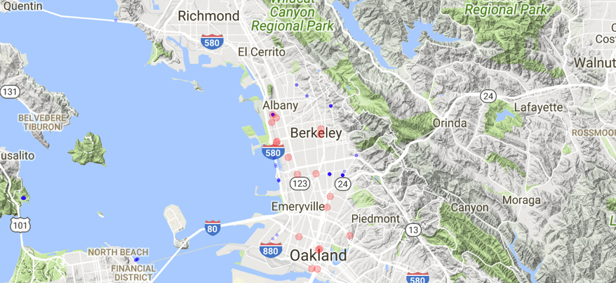
ggmap(mdata,extent = "device", ylab = "Latitude",xlab = "Longitude") +
geom_point(data=photos, aes(x = GPSLongitude, y = GPSLatitude), color="blue") +
geom_point(data=brews, aes(x = lon, y = lat), color="red")

Slide 73
Cautions
Free queries to Google API limited to 1500 per day
Lots of blocked queries without API key
Get ggmap from the author’s GitHub page
Get API key here:
https://console.cloud.google.com/apis/
Use register_google(key = “YOUR KEY”)

Slide 74
Suggestions for this session
Reminder
R Programming and Concepts starting on June 11
R for Researchers at fall semester bootcamp
GitHub page for this presentation.
github.com/nrjjones/BuildingContextualData

